Slide 1

Supervised Learning- Regression
Today’s Agenda
What is Regression?
Types of Regression
Real-World Regression Examples
Intuition Behind Linear Regression
Hands-On Practice
Kahoot(Quiz)

Slide 2
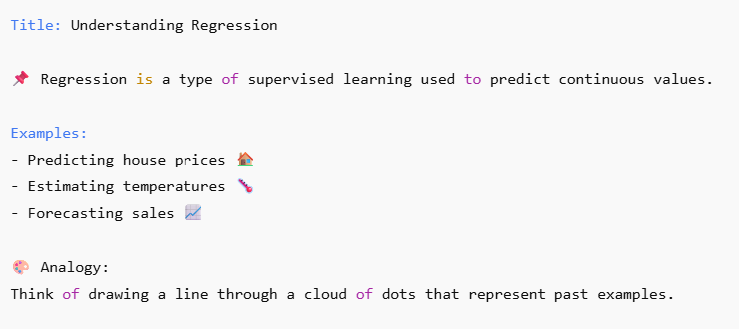
What is Regression?

Slide 3
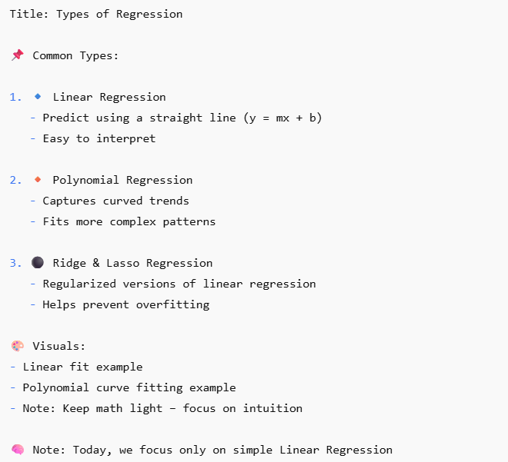
Types of Regression

Slide 4
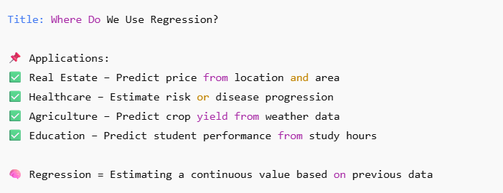
Real-World Regression Examples

Slide 5
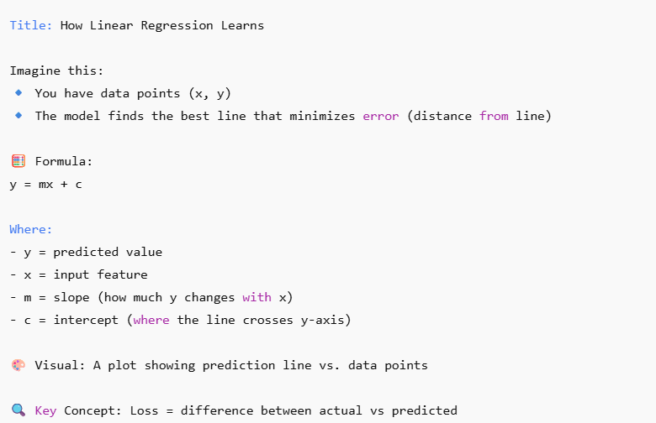
Intuition Behind Linear Regression

